Slide 1
An introduction to hash tables

Slide 2
Outline
9.1
Discuss storing unrelated/unordered data
IP addresses and domain names
Consider conversions between these two forms
Introduce the idea of hashing:
Reducing O(ln(n)) operations to O(1)
Consider some of the weaknesses

Slide 3
Supporting Example
9.1.1
Suppose we have a system which is associated with approximately 150 error conditions where
Each of which is identified by an 8-bit number from 0 to 255, and
When an identifier is received, a corresponding error-handling function must be called
We could create an array of 150 function pointers and to then call the appropriate function….

Slide 4
Supporting Example
9.1.1.1
#include <iostream>
void a() {
std::cout
<< "Calling 'void a()'"
<< std::endl;
}
void b() {
std::cout
<< "Calling 'void b()'"
<< std::endl;
}
int main() {
void (*function_array[150])();
unsigned char error_id[150];
function_array[0] = a;
error_id[0] = 3;
function_array[1] = b;
error_id[1] = 8;
function_array[0]();
function_array[1]();
return 0;
}
Output:
% ./a.out
Calling 'void a()'
Calling 'void b()'

Slide 5
Supporting Example
9.1.1.1
Unfortunately, this is slow—we would have to do some form of binary search in order to determine which of the 150 slots corresponds to, for example, error-condition identifier id = 198
This would require approximately 6 comparisons per error condition
If there was a possibility of dynamically adding new error conditions or removing defunct conditions, this would substantially increase the effort required…

Slide 6
Supporting Example
9.1.1.2
A better solution:
Create an array of size 256
Assign those entries corresponding to valid error conditions
Question:
Is the increased speed worth the allocation of additional memory?
int main() {
void (*function_array[256])();
for ( int i = 0; i < 256; ++i ) {
function_array[i] = nullptr;
}
function_array[3] = a;
function_array[8] = b;
function_array[3]();
function_array[8]();
return 0;
}

Slide 7
Keys
9.1.3
Our goal:
Store data so that all operations are Θ(1) time
Requirement:
The memory requirement should be Θ(n)
In our supporting example, the corresponding function can be called in Θ(1) time and the array is less than twice the optimal size

Slide 8
Keys
9.1.3
In our example, we:
Created an array of size 256
Store each of 150 objects in one of the 256 entries
The error code indicated which bin the corresponding function pointer was stored
In general, we would like to:
Create an array of size M
Store each of n objects in one of the M bins
Have some means of determining the bin in which an object is stored

Slide 9
IP Addresses
9.1.3
Examples:
Suppose we want to associate IP addresses and any corresponding domain names
Recall that a 32-bit IP address are often written as four byte values from 0 to 255
Consider 10000001 01100001 00001010 10110011₂
This can be written as http://129.97.10.179/
We use domain names because IP addresses are not human readable

Slide 10
IP Addresses
9.1.3
Similarly, the University of Waterloo has 2¹⁶ IP addrescontrol of names within its domain
Any IP address starting with 129.97 belongs to UW
This gives UW 256² = 65535 IP addresses
The University of Waterloo currently uses ~60 % of the IP addresses

Slide 11
IP Addresses
9.1.3
Given an IP address, if we wanted to quickly find any associated domain name, we could create an array of size 65536 of strings:
int const MAX_IP_ADDRESSES = 65536
string domain_name[MAX_IP_ADDRESSES];
For example, my computer is churchill.uwaterloo.ca and its IP address is http://129.97.10.179/
The prefix 129.97 is common to all uWaterloo IP addresses
As 179 + 256 × 10 = 2739, it follows that
domain_name[2739] = "churchill";

Slide 12
IP Addresses
9.1.3
Under IPv6, IP addresses are 128 bits
It combines what is now implemented as subnets as well as allowing for many more IP addresses
Suppose uWaterloo is allocated 2⁶⁴ IP addresses under this scheme
We cannot allocate an array of size 2⁶⁴

Slide 13
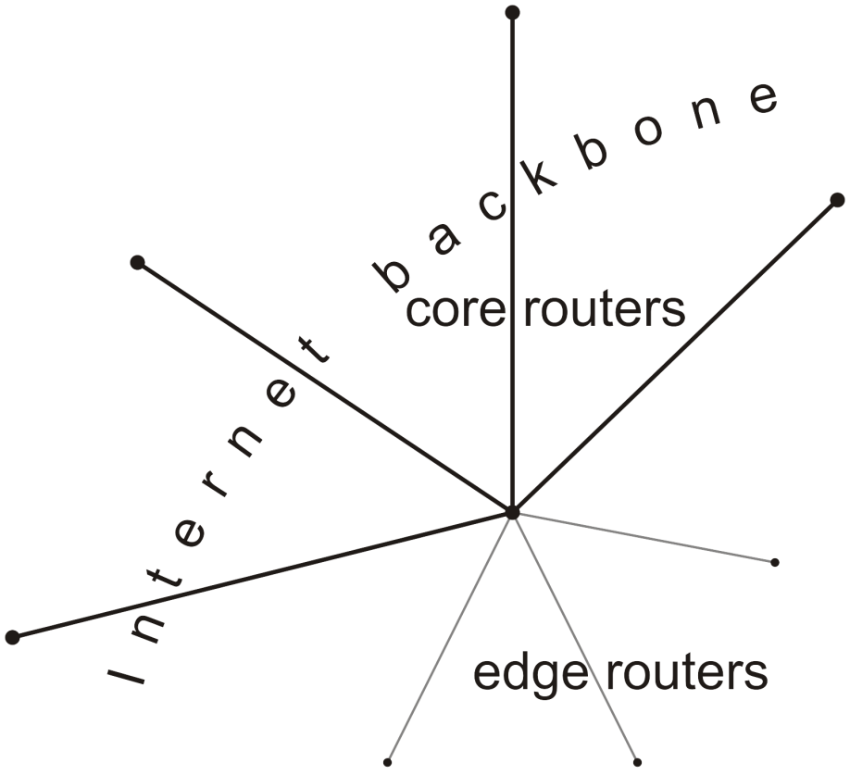
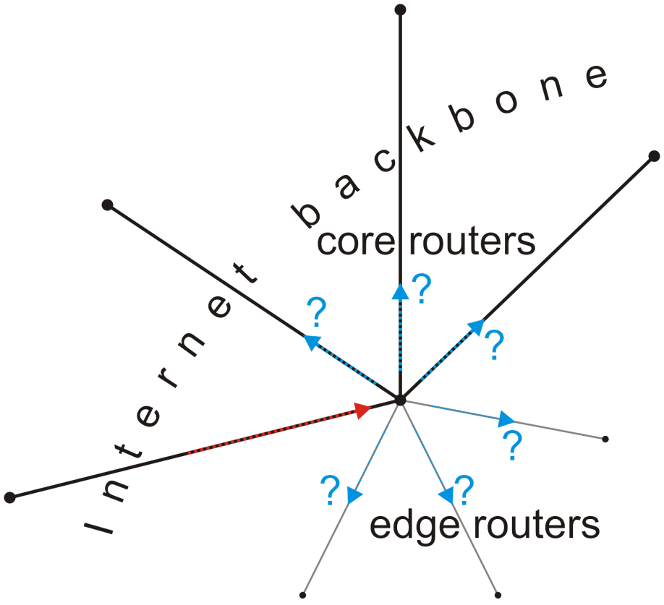
IP Addresses
9.1.3
What if we want to associate domain names with IP addresses?
Which entry in the array should be associated with the domain name churchill.uwaterloo.ca ?
Consider core routers on the Internet:
They must associate each IP address with the next router that address should be passed to

Slide 14
Simpler problem
9.1.3
Let’s try a simpler problem
How do I store your examination grades so that I can access your grades in Θ(1) time?
Recall that each student is issued an 8-digit number
How do I store your examination grades so that I can access your grades in Θ(1) time?
Suppose Jane Doe has the number 20123456
I can’t create an array of size 10⁸ ≈ 1.5 × 2²⁶

Slide 15
Simpler problem
9.1.3
I could create an array of size 1000
How could you convert an 8-digit number into a 3-digit number?
First three digits might cause a problem: almost all students start with 201, 202, 203, 204, or 205
The last three digits, however, are essentially random
Therefore, I could store Jane’s examination grade
grade[456] = 86;

Slide 16
Simpler problem
9.1.3.1
Question:
What is the likelihood that in a class of size 100 that no two students will have the last three digits?
Not very high:

Slide 17
Simpler problem
9.1.3.1
Consequently, I have a function that maps a student onto a 3-digit number
I can store something in that location
Storing it, accessing it, and erasing it is Θ(1)
Problem: two or more students may map to the same number:
Wěi Wang has ID 20173456 and scored 85
Alma Ahmed has ID 2024456 and scored 87
...
...
454
455
456 | 86
457
458
459
460
461
462
463 | 79
464
465
...
...

Slide 18
The hashing problem
9.1.3.1
The process of mapping an object or a number onto an integer in a given range is called hashing
Problem: multiple objects may hash to the same value
Such an event is termed a collision
Hash tables use a hash function together with a mechanism for dealing with collisions

Slide 19
IP Addresses
9.1.3.1
Going back to the problem with IP addresses
We need a hash function to map an IP address to a smaller range
We need a hash function to map a domain name to a smaller range
Mapping 129.97.10.179 onto a smaller range may seem easier, but a mechanism for mapping churchill.uwaterloo.ca onto a small range of integers may be more interesting

Slide 20
The hash process
9.1.4
Object
We will break the process into three independent steps:
We will try to get each of these down to Θ(1)
Techniques vary...
32-bit integer
Modulus, mid-square, multiplicative, Fibonacci
Map to an index 0, ..., M – 1
Deal with collisions
Chained hash tables
Open addressing
Linear probing
Quadratic probing
Double hashing

Slide 21
Summary
Discuss storing unordered data
Discuss IP addresses and domain names
Consider conversions between these two forms
Introduce the idea of using a smaller array
Converted “large” numbers into valid array indices
Reduces O(ln(n)) in arrays and AVL trees to to O(1)
Discussed the issues with collisions

Slide 22
References
Wikipedia, http://en.wikipedia.org/wiki/Hash_table
[1] Cormen, Leiserson, and Rivest, Introduction to Algorithms, McGraw Hill, 1990.
[2] Weiss, Data Structures and Algorithm Analysis in C++, 3rd Ed., Addison Wesley.
These slides are provided for the ECE 250 Algorithms and Data Structures course. The material in it reflects Douglas W. Harder’s best judgment in light of the information available to him at the time of preparation. Any reliance on these course slides by any party for any other purpose are the responsibility of such parties. Douglas W. Harder accepts no responsibility for damages, if any, suffered by any party as a result of decisions made or actions based on these course slides for any other purpose than that for which it was intended.

